Slide 1
Regional Sales and Customer Insights Dashboard
By: Shaili Likhar

Slide 2
Project Overview
Project Overview: This project aims to provide insights into regional sales performance and customer profitability, enabling strategic decision-making to increase business across regions.
Objective: Analyze customer statistics, sales, and profit to identify key trends and opportunities across different regions.

Slide 3

Data Overview
Dataset Used: The dashboard is built using the Sample Superstore dataset, which includes data on customer purchases, sales, quantities, and profits.
Key Metrics: Number of customers, total sales, quantity sold, sales per customer, profit, and profit per customer.

Slide 4
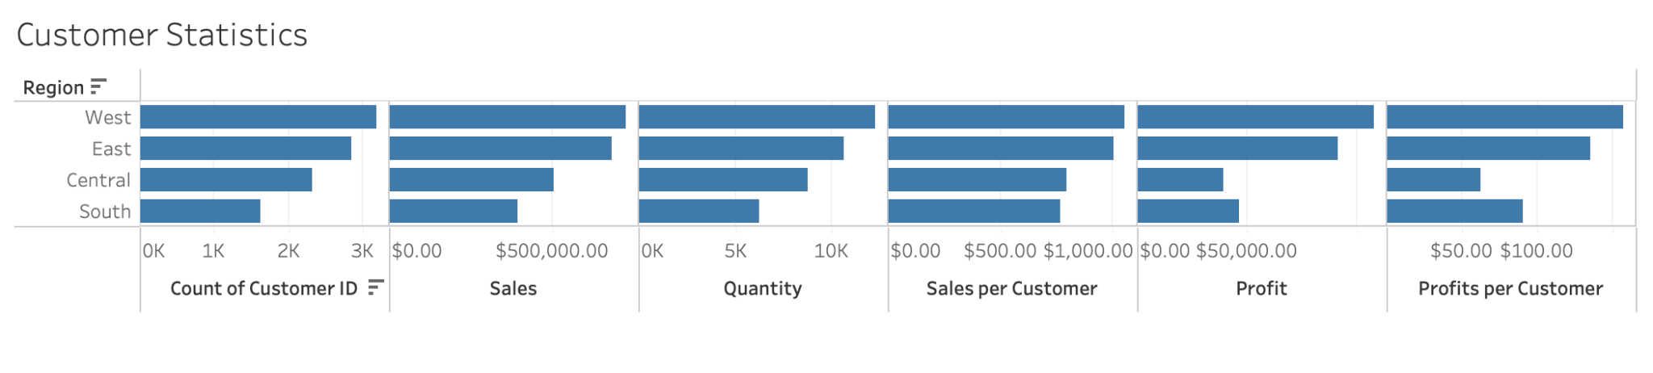
Customer Statistics
Explanation: This section breaks down customer statistics by region, providing insights into the number of customers, total sales, quantities sold, sales per customer, profit, and profits per customer. It allows quick comparison across different regions to identify strong and weak areas.

Slide 5
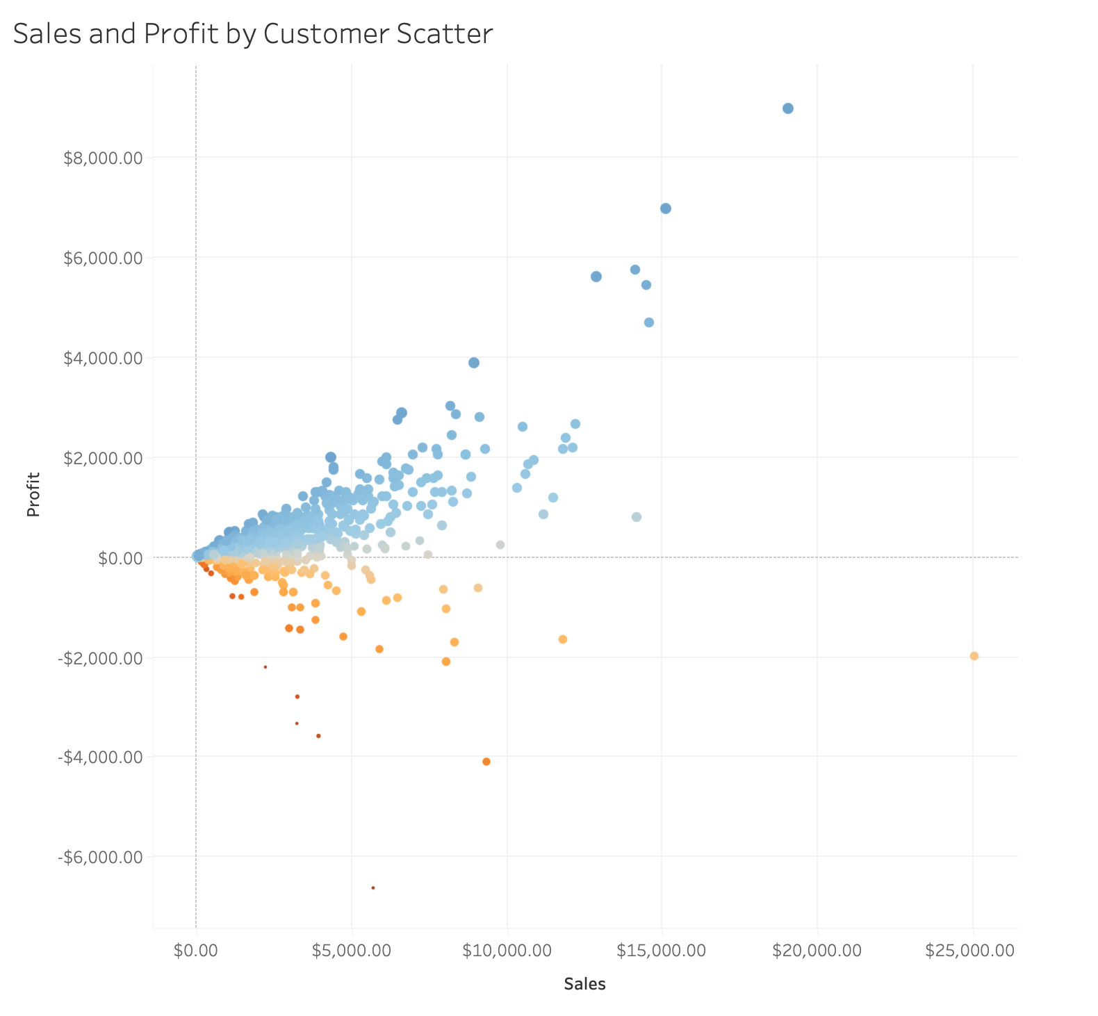
Sales and Profit by Customer
Explanation: The scatter plot visualizes the relationship between sales and profit for individual customers, color-coded by profit ratio. This helps identify which customers are contributing most to the profits and which might be generating sales but with lower profitability.

Slide 6
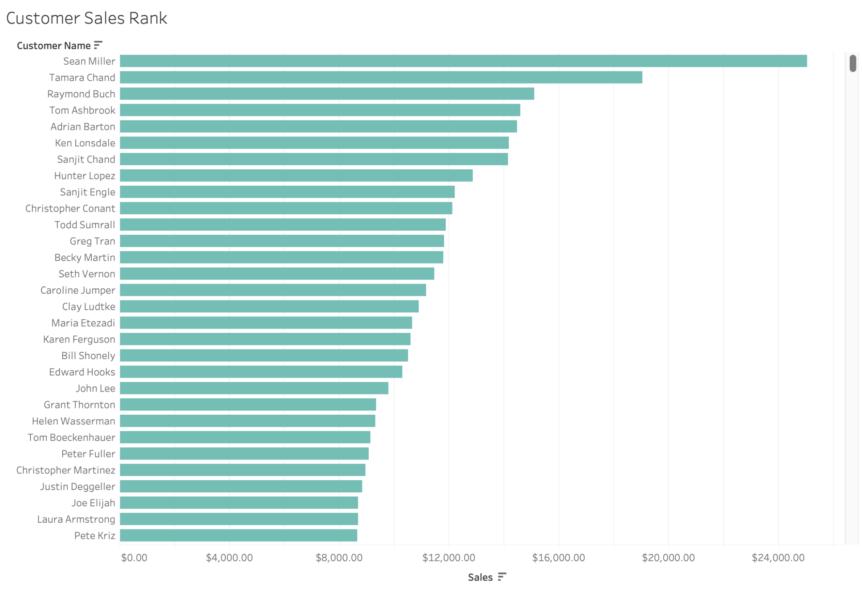
Customer Sales Rank
Explanation: This chart ranks customers by their total sales, helping to identify the top-performing customers and focusing efforts on maintaining and growing these relationships.

Slide 7
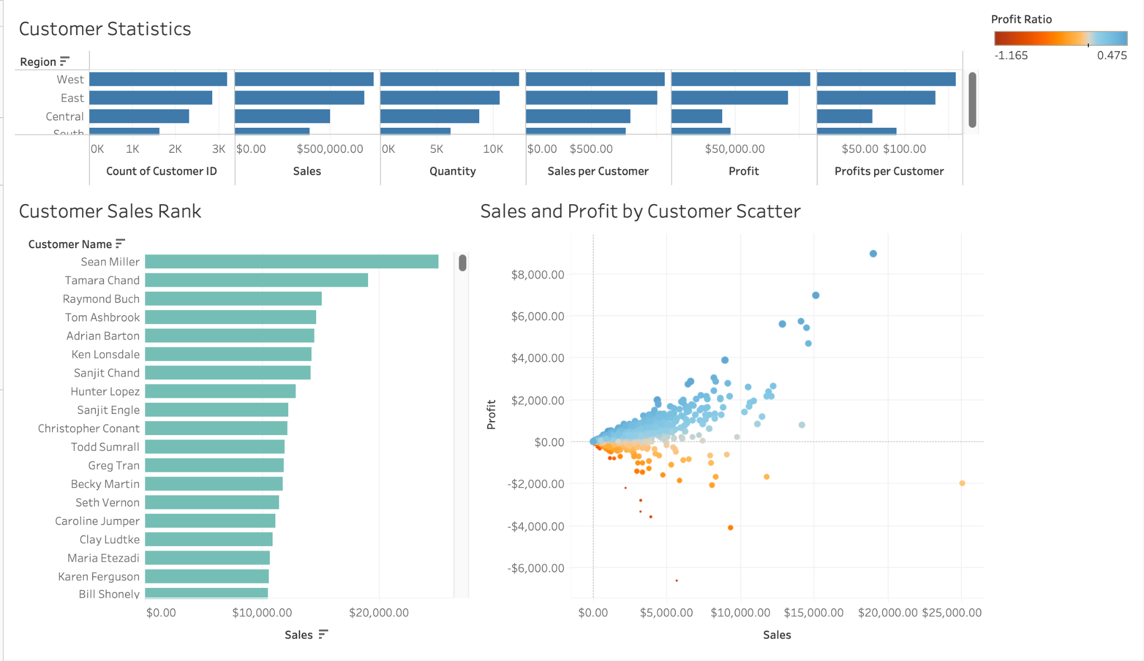
Dashboard Overview
Explanation: The dashboard integrates customer statistics, customer sales rank, and sales and profit analysis by region. It allows for a comprehensive view of performance metrics that can be easily compared across regions.

Slide 8
Key Insights & Recommendations
Key Insights:
Regional Performance: The West region has the highest number of customers and sales, while the South region is lagging behind
Profitability: There are customers with high sales but low profitability, which may need a different sales strategy
Customer Focus: The top customers, like Sean Miller and Tamara Chand, should be prioritized for retention and upselling
Recommendations:
Focus on Underperforming Regions: Develop targeted strategies to boost sales and profitability in weaker regions like the South
Profit Optimization: Review pricing or cost structures for customers with low profit margins despite high sales
Customer Relationship Management: Enhance relationships with top-ranking customers to ensure continued business

Slide 9
Conclusion
Recap: The dashboard provides a clear view of customer statistics and sales performance by region, helping to inform data-driven decisions to improve business outcomes
Next Steps: Consider further analysis, such as customer segmentation or predictive modeling, to refine strategies and actions

Slide 10
Thank You!
Contact Information:
Email: shaililikhar@gmail.com
LinkedIn: https://www.linkedin.com/in/shaili-likhar/
I appreciate your time and attention.

